Slide 1
Building a Sales Dashboard in Power BI for Superstore Dataset
Project Description:
The project involves creating a dashboard using Power BI to visualize and analyze sales data for the Superstore Sales dataset.
by DataAsh21

Slide 2

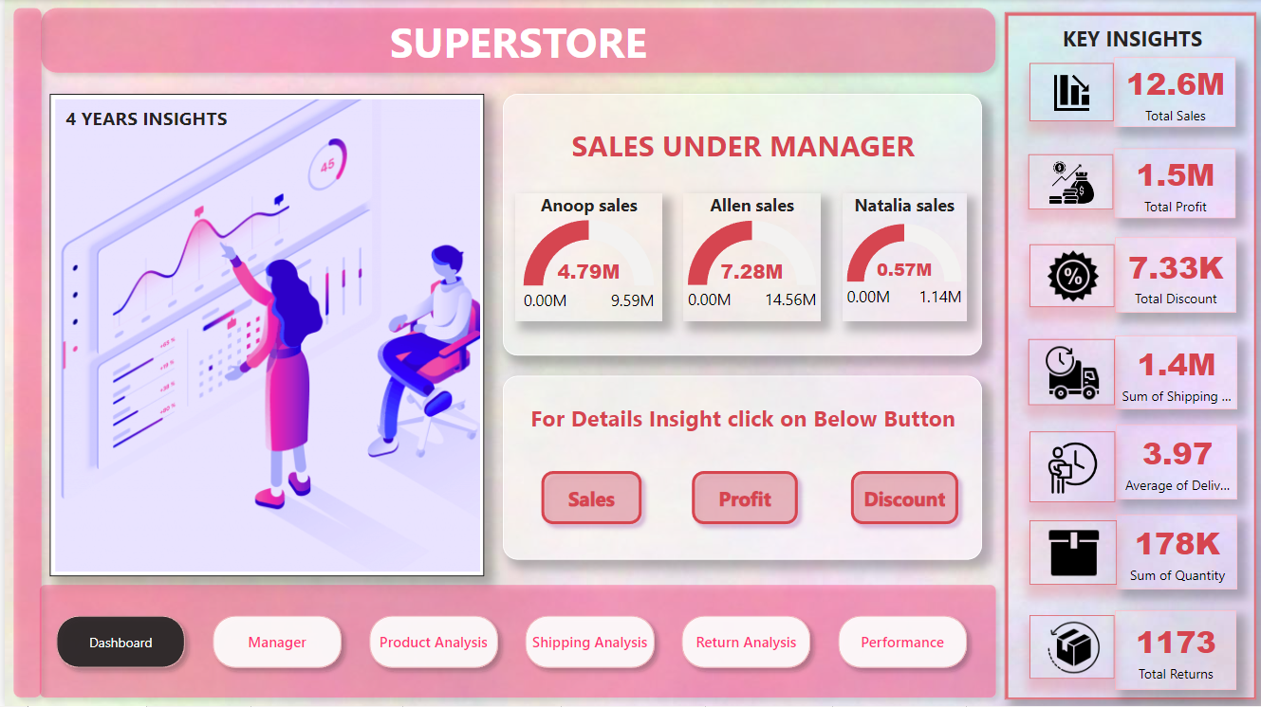
Project Overview:
This project is focused on creating a comprehensive dashboard using the Power BI tool. The dashboard is designed to provide insights into the sales performance of a Superstore across various categories and regions.
To create this dashboard, I used the ETL (Extract, Transform, Load) process to clean and process the raw data from the Superstore Sales dataset. The ETL process involved extracting the data from its source, transforming it to make it usable, and loading it into Power BI for analysis.
The Superstore Sales dataset used in this project is a large and complex dataset containing sales data for a retail store over several years. The dataset includes information on sales, profits, discounts, returns, and quantities sold across various product categories, regions, and managers.
Using Power BI, I was able to create interactive visualizations that allow users to easily explore and analyze the data. The dashboard includes a variety of charts, tables, and graphs that provide insights into sales performance, product categories, regions, and managers.
The dashboard includes multiple pages with different visualizations and filters. The client requirements were taken into account during the development process.
Overall, this project demonstrates the power of Power BI in analyzing large datasets and presenting insights in a clear and understandable way.

Slide 3
My Responsibilities:
ETL Process:
Extracted the Superstore Sales dataset and cleaned the data.
Extract: The Superstore Sales dataset was extracted from the source.
Performed data transformation and created DAX measures for sales, profit, discount, returns, and quantity sold.
Transform: The data was cleaned and processed to remove duplicates, fix errors, and format the data.
Developed the Power BI dashboard and created multiple pages with different visualizations.
Load: The cleaned data was loaded into Power BI for analysis and visualization.
Incorporated client feedback and made changes to the dashboard as needed.

Slide 4

Data Analysis:
After cleaning the data, we have analyzed the Superstore sales dataset by creating various measures and columns. The measures that we have created include Total Sales, Total Profit, Total Discount, Total Returns, and Sold Quantity. We have also created a conditional column named 'Manager Responsible' to identify the manager responsible for handling the orders based on the order priority. The three managers are Anoop, Allen, and Natalia, with Anoop handling critical and high priority orders, Allen handling medium priority orders, and Natalia handling low priority orders.
We have also created a conditional column named 'Returned-Order' to identify the returned orders from the return table. Additionally, we have calculated the Delivery Days column by subtracting the order date from the ship date.

Slide 5
DAX Expression for All Measure:-
Total Sales = SUM(Orders[Sales])
Total Profit = SUM(Orders[Profit])
Total Discount = SUM(Orders[Discount])
Total Returns = SUM(Returns[Returns Orders])
Total Returns = SUM(Returns[Returns Orders])

Slide 6
DAX Expression for All Column:
Conditional Column - Manager Responsible
We created a conditional column called 'Manager Responsible' to identify the manager responsible for handling the orders based on the order priority.
Manager Responsible = IF(Orders[Order Priority] = "Critical" || Orders[Order Priority] = "High", "Anoop", IF(Orders[Order Priority] = "Medium", "Allen", "Natalia") )
Conditional Column - Returned Order
We also created a conditional column called 'Returned-Order' to identify the returned orders from the return table.
Returned-Order = IF(Returns[Returned] = "Yes", 1, 0)
Custom Column - Delivery Days
To calculate the delivery days, we created a custom column called 'Delivery Days' by subtracting the order date from the ship date.
Delivery Days = DATEDIFF(Orders[Order Date], Orders[Ship Date], DAY)

Slide 7
Dashboard Pages:
1
Overview Page:
Manager Analysis Page:
2
3
Product Analysis Page:
Shipping Analysis Page:
4
5
Return Analysis Page:
Performance Page:
6

Slide 8
Overview Page:
Manager Analysis Page:
Product Analysis Page:
This page provides a high-level overview of the sales, profits, and discounts.
This page provides a detailed analysis of the sales, profits, and discounts handled by each manager.
This page provides a detailed analysis of the sales, profits, and discounts of each product.
It includes three bookmark buttons, namely Sales Dashboard, Profit Dashboard, and Discount Dashboard, that allow users to navigate to the respective pages.
It includes a details button that, with the help of a bookmark, allows users to view more detailed information about a specific product.
It includes three bookmark buttons, namely Anoop, Allen, and Natalia, that allow users to navigate to the respective pages for a more in-depth analysis.

Slide 9
Shipping Analysis Page:
Return Analysis
Page:
Performance Page:
This page provides a detailed analysis of the top and bottom performers in terms of sales.
This page provides a detailed analysis of the shipping of orders.
This page provides a detailed analysis of the returns of orders.
It includes a details button that, with the help of a bookmark, allows users to view more detailed information about the shipping
It includes a details button that, with the help of a bookmark, allows users to view more detailed information about the returns.
It includes two buttons, namely Top 3 Performance and Bottom 3 Performance, that allow users to view the top and bottom performers in every manner.
Additionally, it includes a tooltip on the order priority in the visuals to view more detailed information.

Slide 10
Custom Slicer:
Page Navigator:
In this project, I also created a custom slicer filter on the manager page. This slicer filter allows users to see the performance of managers by city and country.
To make navigation between pages easier, I used the page navigator feature in Power BI.
This feature allows users to move from one page to another by clicking on the page name on the navigation bar.
To make the slicer filter user-friendly, I created a button with the help of a bookmark that shows all filter options to customers.

Slide 11
Client Requirements:
The client requested a dashboard that:
Displays sales, profit, and discount data by region, category, and product, and allows for easy exploration of the data using filters and visualizations.
Displays all KPIs on the overview page.
Provides a page for analyzing performance, including top 3 performing and bottom 3 performing products for sales and trends over time.
Allows the client to view sales, profit, and discount trends over time.
Breaks down sales, profit, and discount by region and manager.
Enables filtering of the dashboard by time period, product category, sub-category, city, region, and country.
Allows for comparison of sales and profit between managers Anoop, Allen, and Natalia.
Enables filtering of data based on date range, category, sub-category, region, segment, and manager.

Slide 12

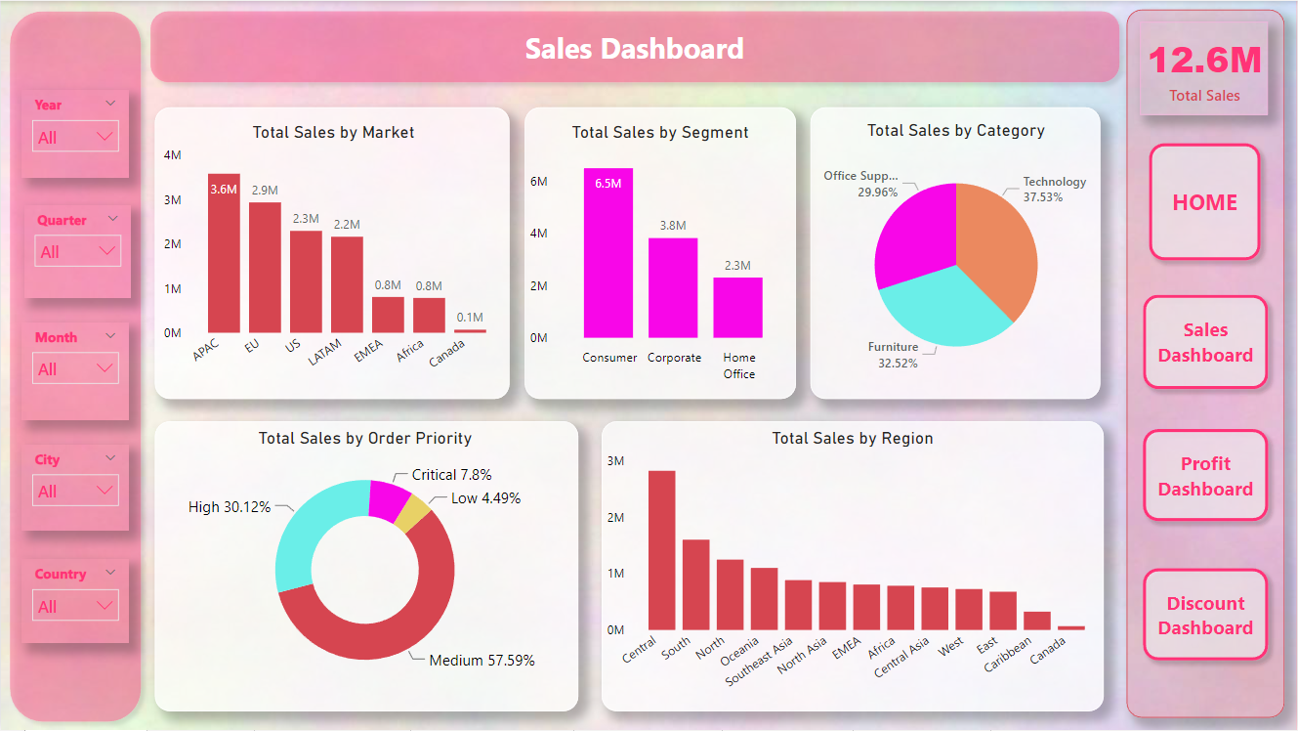
Conclusion:
In conclusion, building a sales dashboard for the Superstore dataset using the Power BI tool required various skills, including data cleaning, data processing, data analysis, and DAX query manipulation. The six-page analysis, including the overview page, manager analysis page, product analysis page, shipping analysis page, return analysis page, and top and bottom performance page, helped users to make informed decisions based on the insights provided.
The custom slicer filter and page navigator enhanced the user experience and made navigation and data exploration more convenient. By meeting the client requirements, the dashboard provides a comprehensive view of the Superstore's sales performance and facilitates data-driven decision-making.
For more detailed information, please refer to the Power BI dashboard and explore the various pages and visualizations.

